Slide 2
objectives
Render image color given spectral information
Find hyperspectral image databases
Demonstrate how color changes under varying illumination
Color information is affected by light source, object spectral property, and sensor sensitivity.
Spectral information is a more stable descriptor of an object.
There is a variety pf hyperspectral databases available.
Converting spectral information into color is necessary for many reasons.

Slide 3
Background
Color is trinity which implies that what we see is a product of three things: (1) the emittance of the source, (2) reflectance of the object, and (3) the sensor sensitivity. Among the three, only the surface reflectance is the property of the object hence, changing the source and the sensor can totally change how the object looks. This makes the color a subjective property of the object. In this activity, I demonstrate how color is rendered and how it changes perceptually under different illuminations.

Slide 4














Methodology
Trinity of color.
Sensor Model.
$$V_{n}=\int_{λ}{C\left(λ\right)S_{n}\left(λ\right)ⅆλ}=\int_{λ}{P\left(λ\right)R\left(λ\right)S_{n}\left(λ\right)ⅆλ}$$
$$\overline{V_{n}}=\frac{\int_{λ}{P\left(λ\right)R\left(λ\right)S_{n}\left(λ\right)ⅆλ}}{\int_{λ}{P\left(λ\right)S_{n}\left(λ\right)}}$$

Slide 5
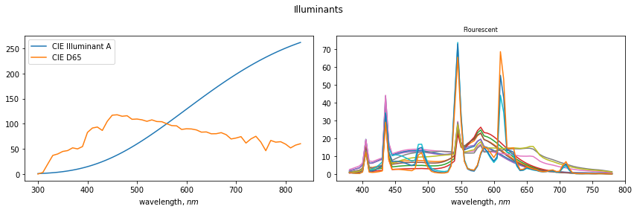
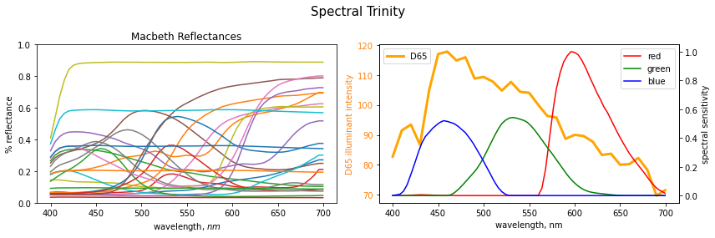

Slide 6
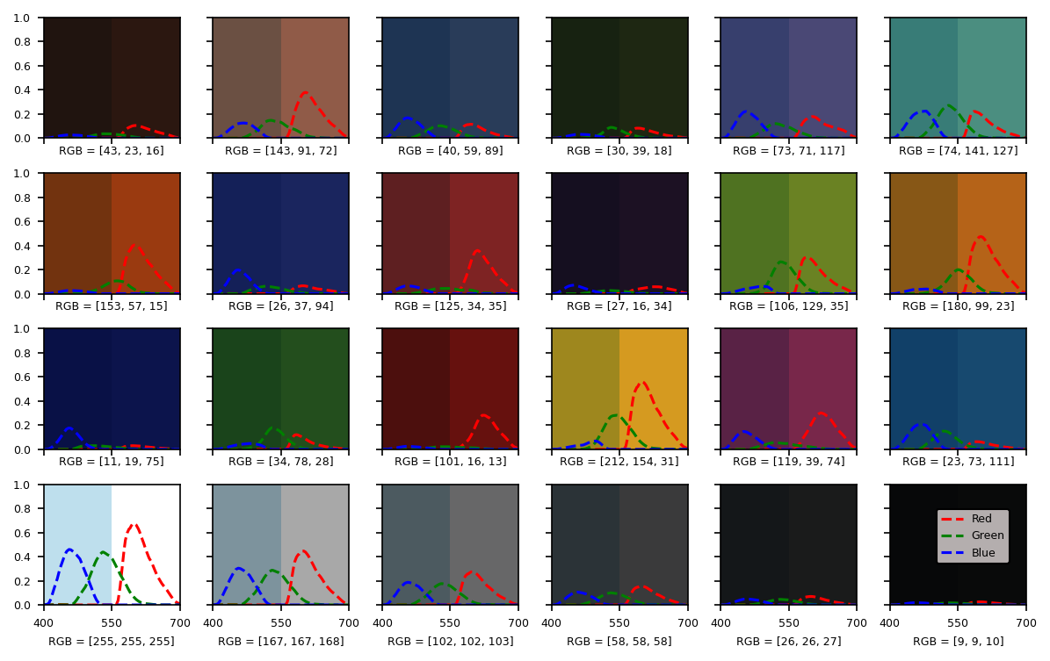
Color Simulation

Slide 7
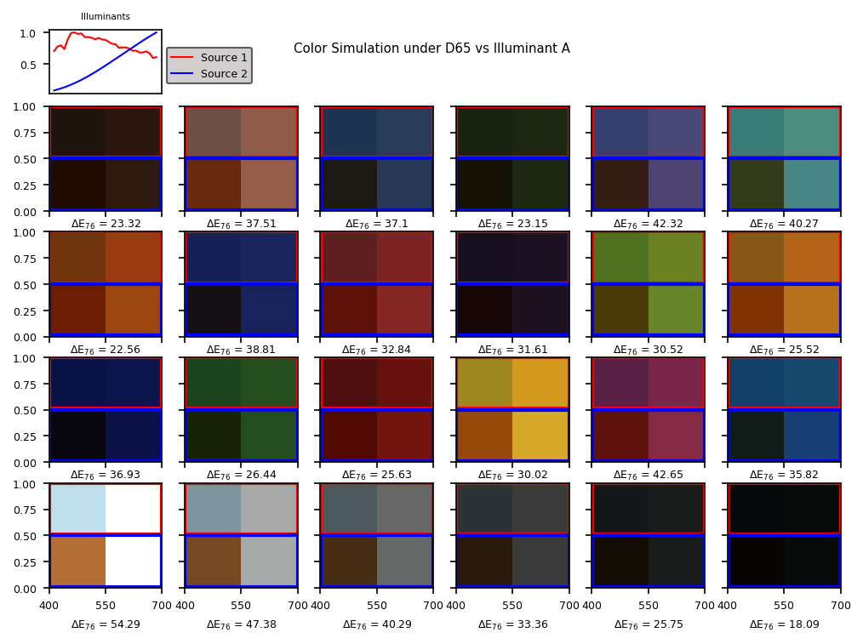

Slide 8
